Slide 1
PROCEDURE.
Milind Parab

Slide 2
Procedure.
Procedure is a usable processing block, it is used to handle business calculation, formulas, roles, conditions etc.
Types of Procedures:
1. Basic.
2. With Input and Output Parameters.
3. Without Input and Output Parameters.
4. With Input Parameters.
5. With Output Parameters.

Slide 3
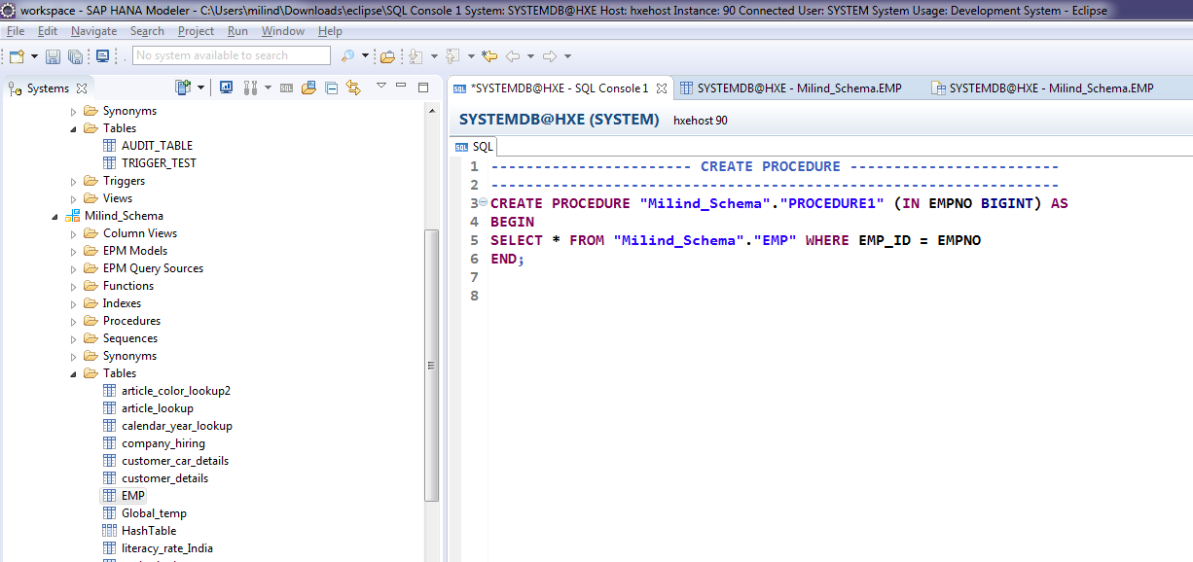
Create Procedure.

Slide 4
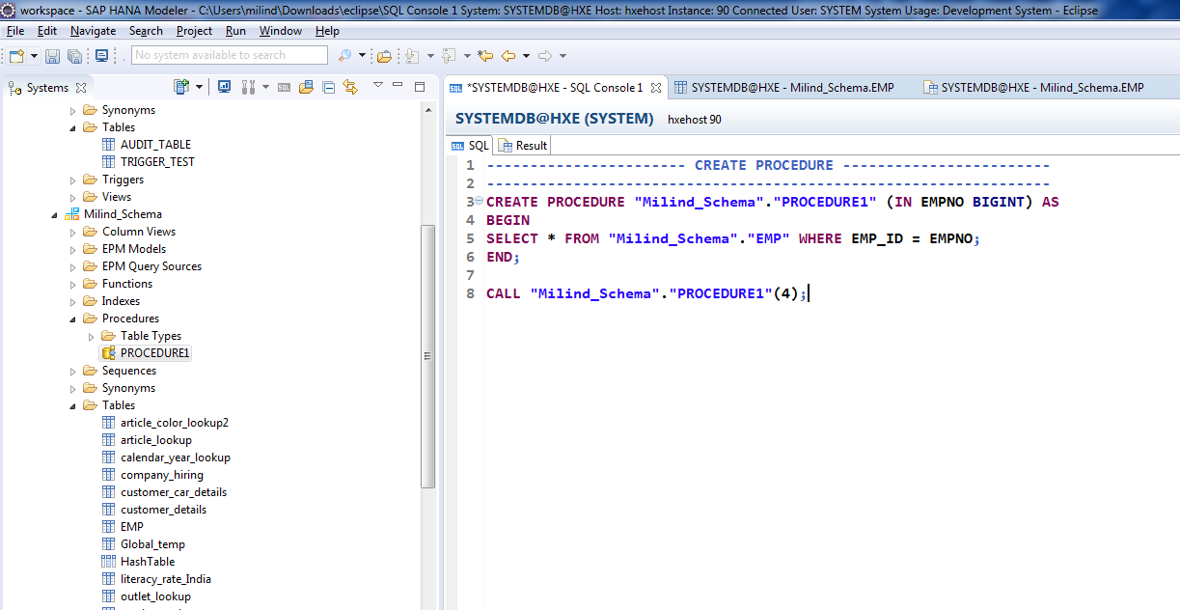
Cont.

Slide 5
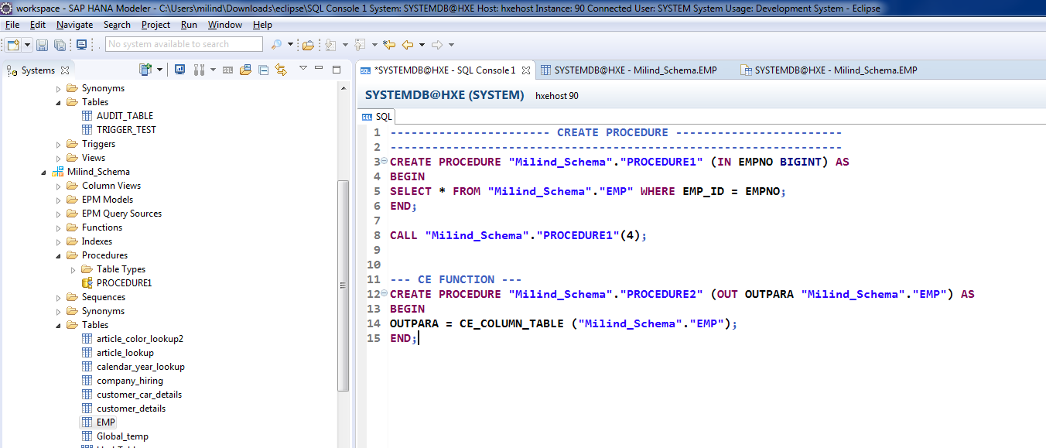
CE Function.

Slide 6
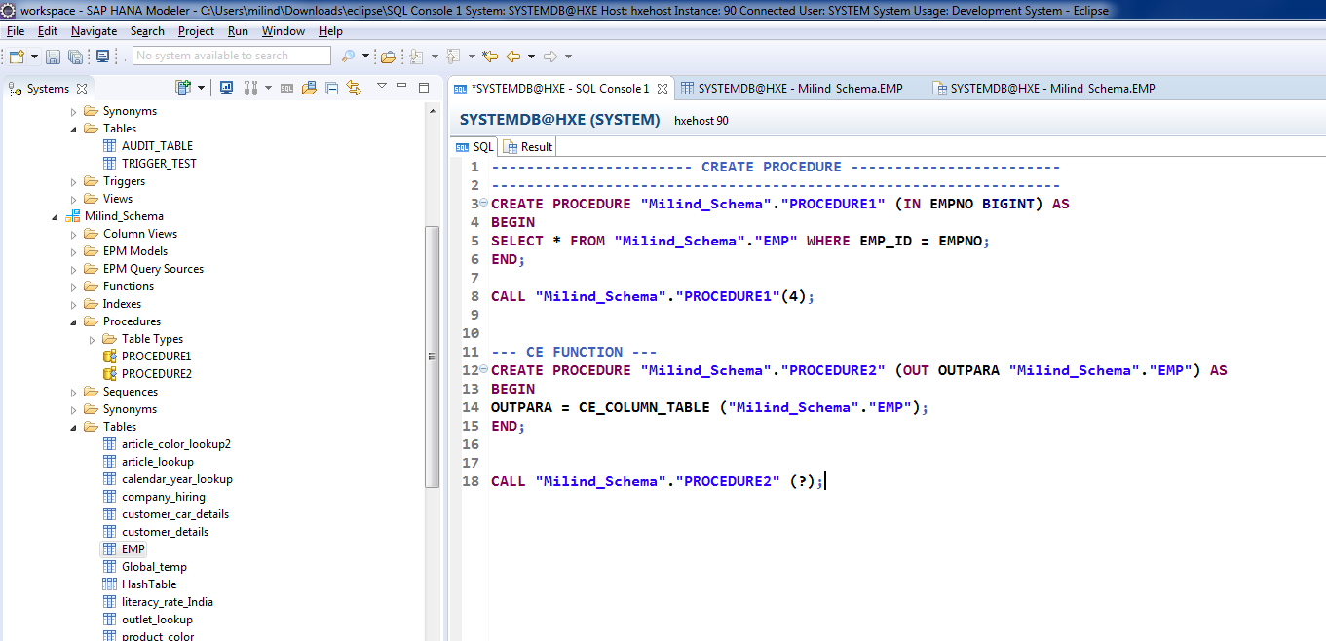
Call Procedure.

Slide 7
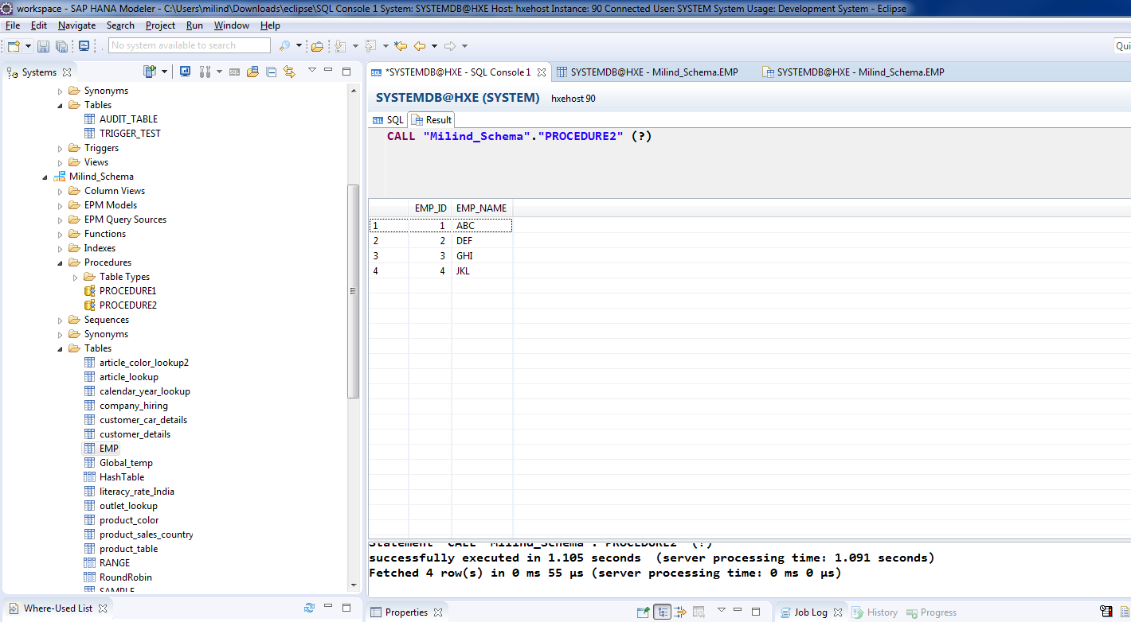
Output.

Slide 8
Table Type
Table type used to store data while stored procedure is executing.
It holds the data temporary.
We can’t add record to table type.
If you try to insert a record in table type, you will end up getting an error.

Slide 9
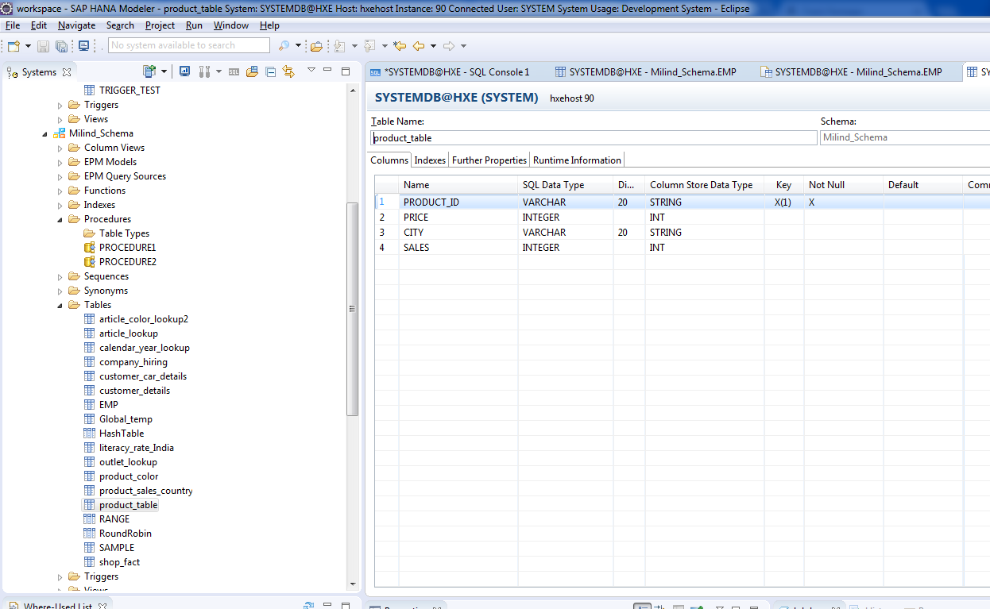
Create a Table Type.

Slide 10
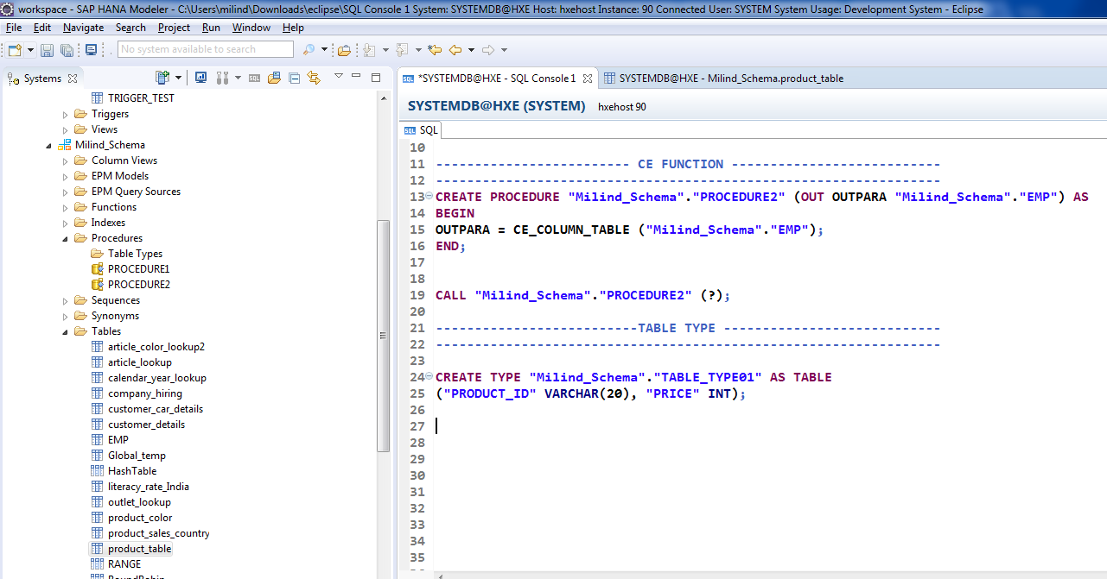
Table Type.

Slide 11
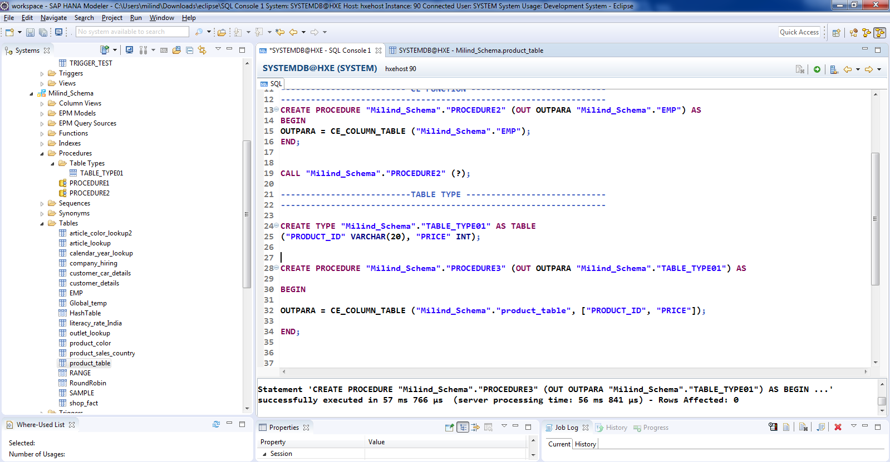
Cont.

Slide 12
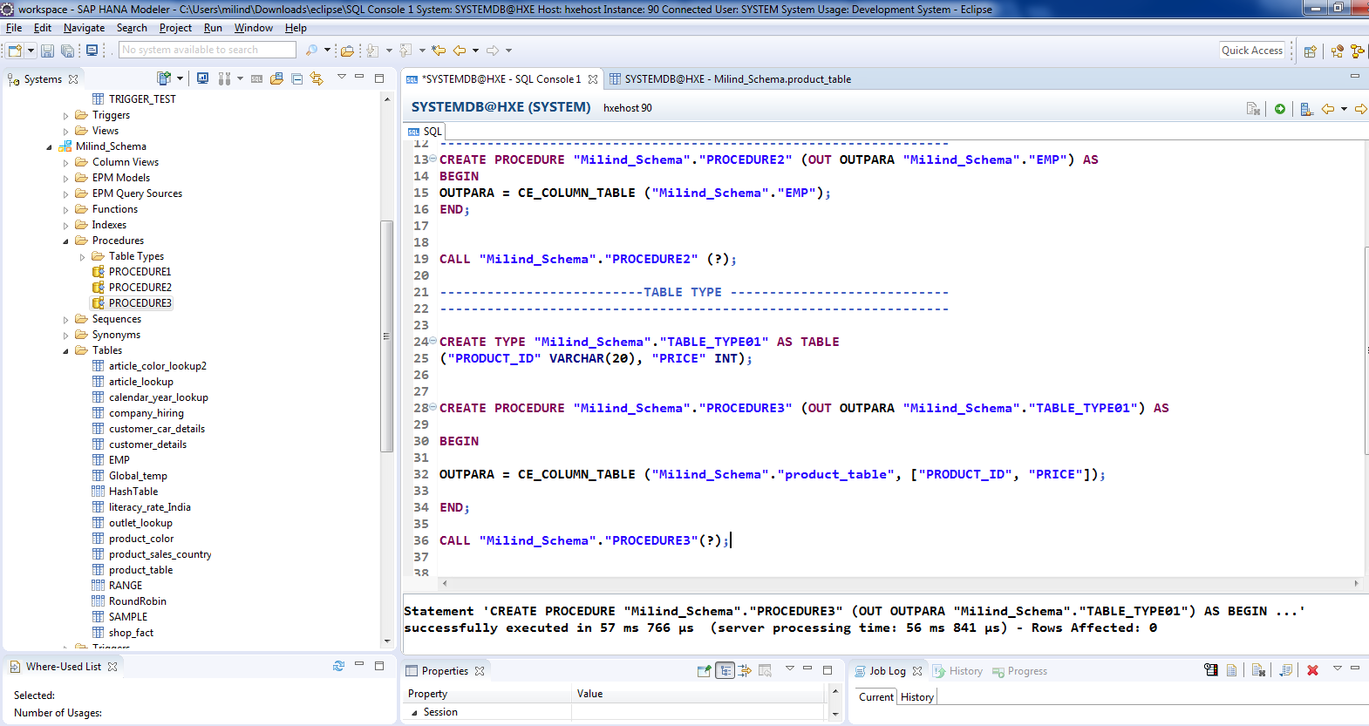
Cont.

Slide 13
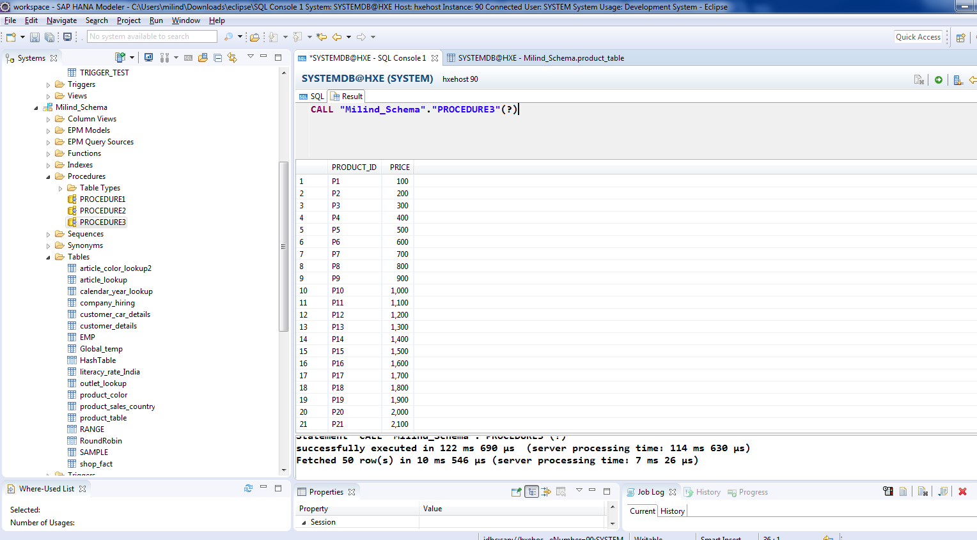
Output.

